Slide 1

Exploring and Predicting
Airbnb Listing Prices in Boston
Presented by : Spark
Jimmy Hu, Robert Malongo, Steve Xu

Slide 2
Workflow
Descriptive Statistics
Feature Engineering
Sampling & Modeling
Conclusion
Host Information
Neighborhood
Sampling Method
Policy
Time Effects
OLS Regression
Room
Text Mining
Machine Learning
Review
01

Slide 3
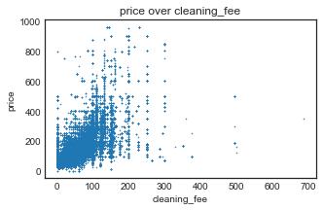
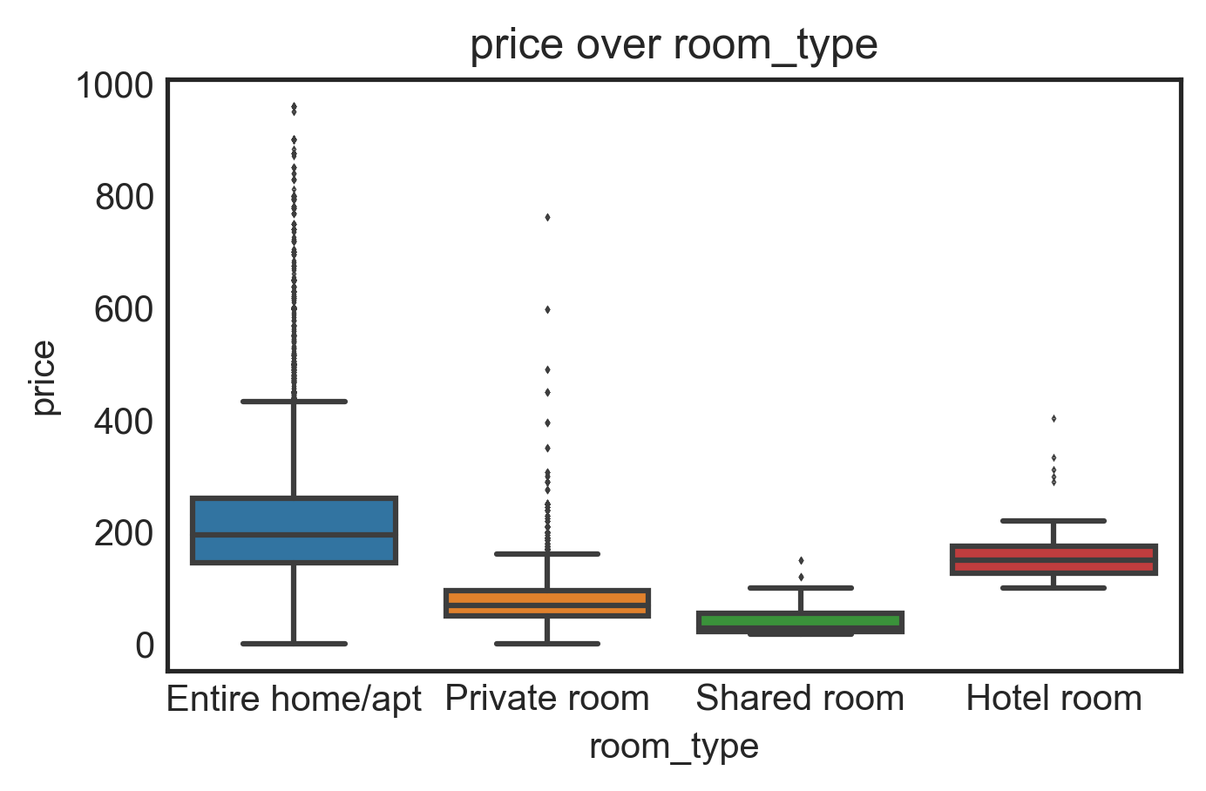
Features: Summary
Bivariate Relationship Test of Variables v.s.Price
Variables From Datasets v.s. Variables Created:
Host, Policy, Review, Room Type
Neighborhood, Time Effects, Description
Neighborhood, size and time affect price the most
02

Slide 4
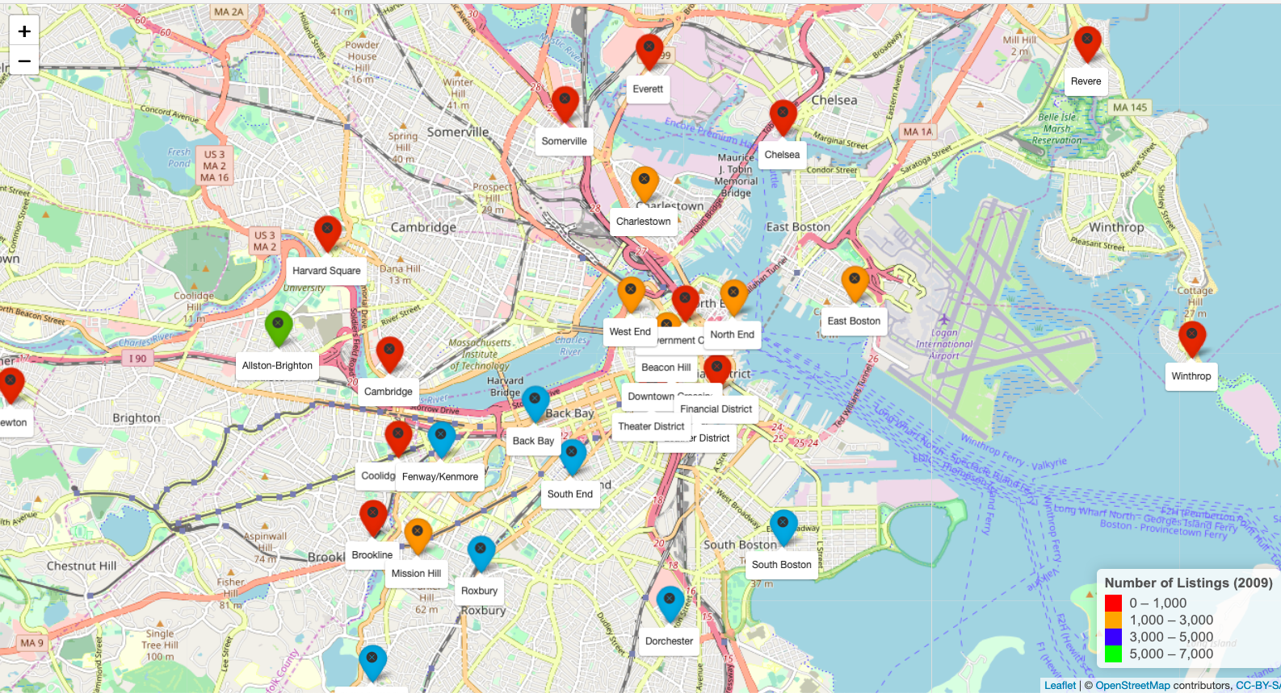
Neighborhood: Market Share
Highest
Allston - 11%
Dorchester - 9%
Backbay - 8%
Others
Less than 1%
Boston Map
03

Slide 5
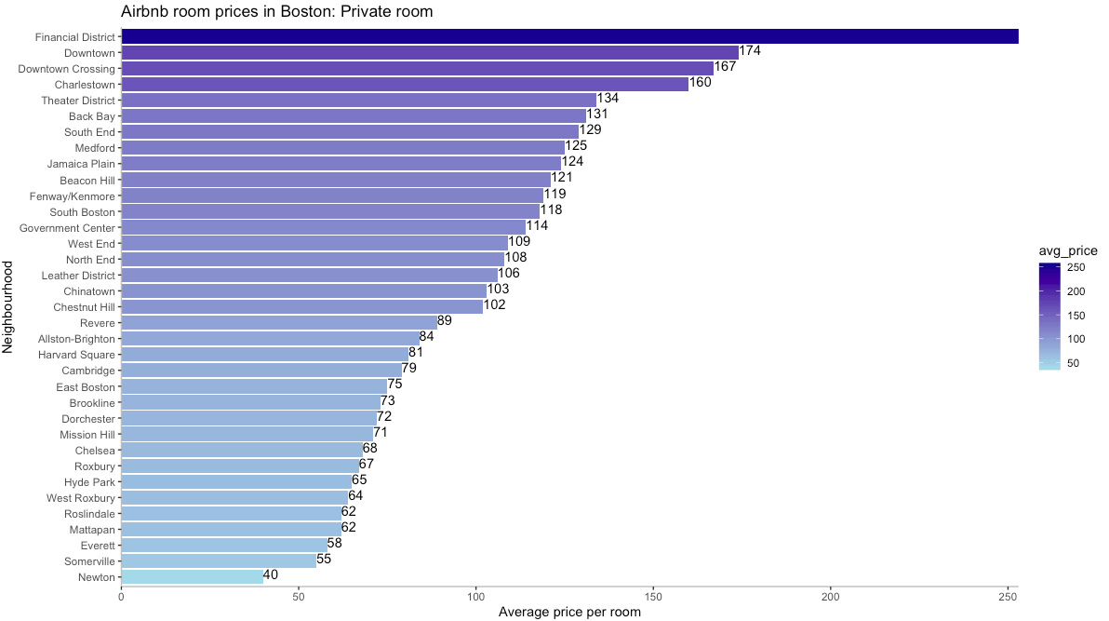
Neighborhood: Prices
Assumption
Closer to Boston downton,
higher listing price
Highest
1.5 mi radius of downtown
Lowest
> 4.0 mi radius of downtown
253
04
Notes:
Newton(10.9 mi),
Everett (4.3mi)
Somerville (3.9mi)

Slide 6
Neighborhood: Income Distribution
Assumption
Richer neighborhoods, higher listing price
US Census Bureau 2017 data
Variable | Category | Median HH income | Value | Description
Income_level | Low | 0-$49,999 | 1 | Score for each neighborhood
 | Middle-low | $50,000-$99,999 | 2
 | Middle-upper | $100,000-$149,999 | 3
 | Upper | ≥ $150,000 | 4
05
Notes:
Median income for Boston is $66,758

Slide 7
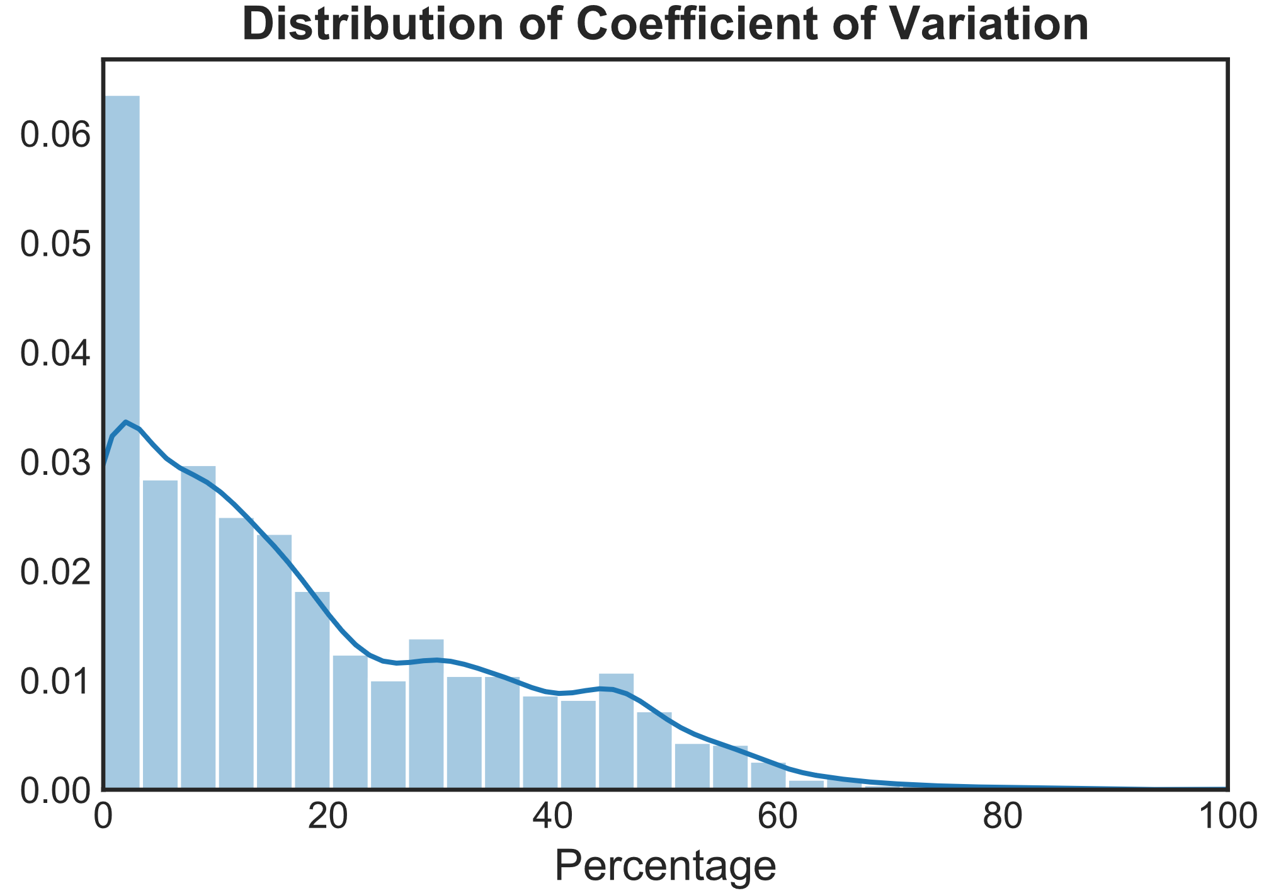
Time Effects: Description
Exploration
50% variations are greater than 15%
25% variations are greater than 30%
Undeniable time effect
Challenge
Unbalanced panel data
06

Slide 8
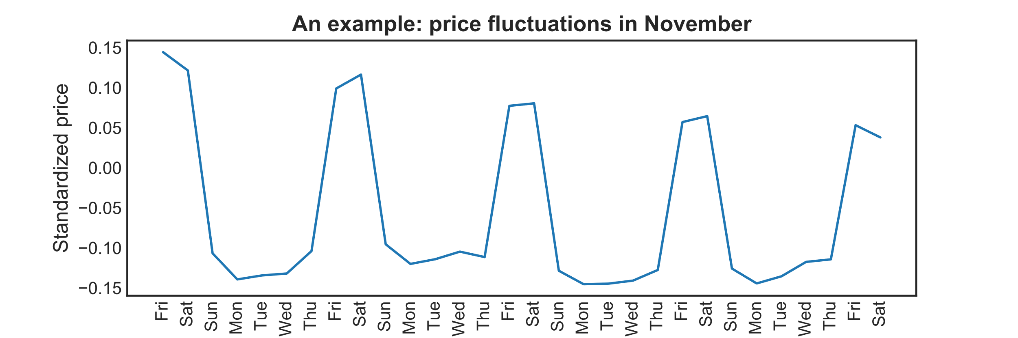
Time Effects: Weekday
Regular fluctuations on Friday and Saturday
07

Slide 9
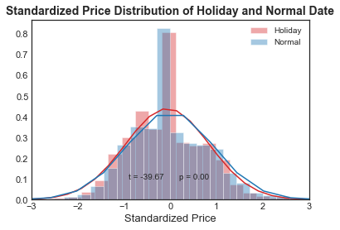
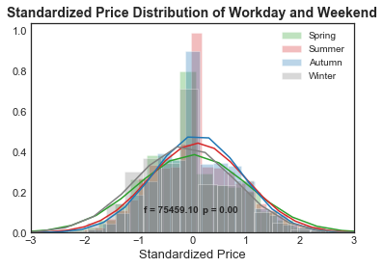
Time Effects: Holiday & Season
Significant effects from holidays and seasons
08

Slide 10
Time Effects: New Features
Extract useful features from time variable
Variable Name | Value | Description
is_Fri_Sat | 1 | Friday or Saturday
 | 0 | Other
is_holiday | 1 | Holiday
 | 0 | Other
season | 1 | Sprint (Mar - May)
 | 2 | Summer (Jun - Aug)
 | 3 | Autumn (Sep - Nov)
 | 4 | Winter (Dec - Feb)
09

Slide 11
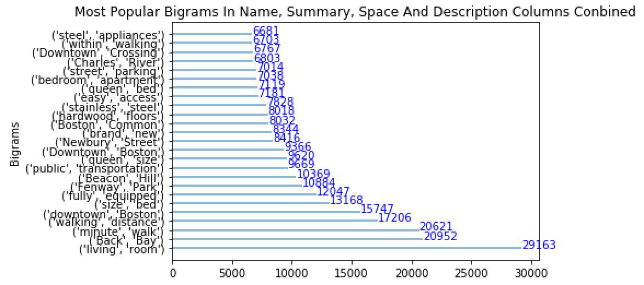
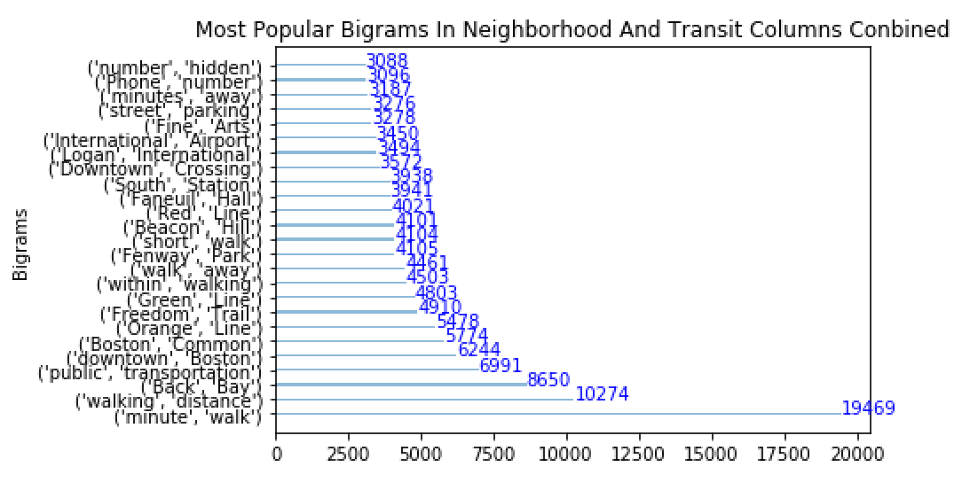
Description: Text Mining
Assumption: More hot words the description hits, higher the price
Observation: Bigrams tell more than single words
Location matters more than convenience
Engineering: Features based on if text hit hot bigrams
10

Slide 12
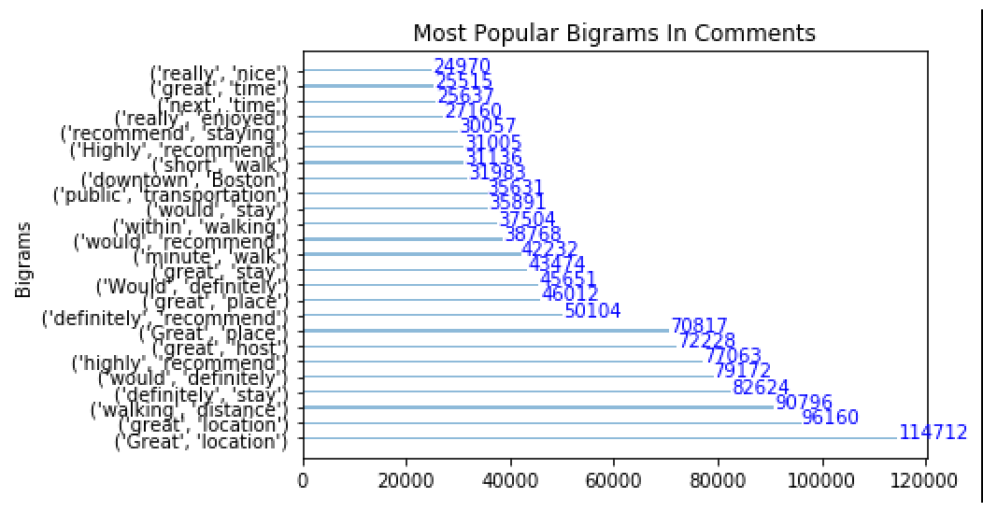
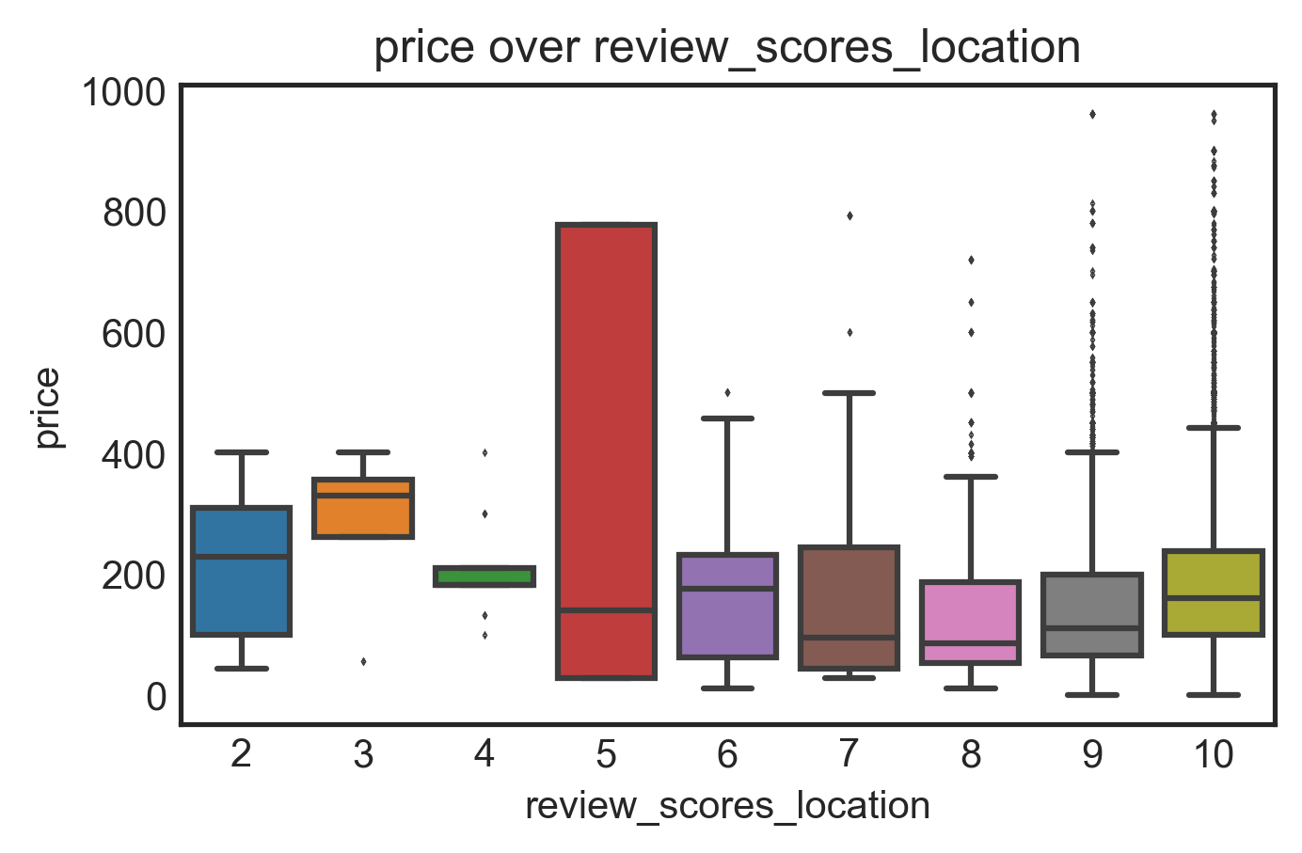
Reviews: Text Mining And Scores
Assumption: More trending reviews/higher scores, higher the price
Observation: Locations matter
Review scores? Yes and no
Engineering: Features based on reviews hitting hot bigrams
11

Slide 13
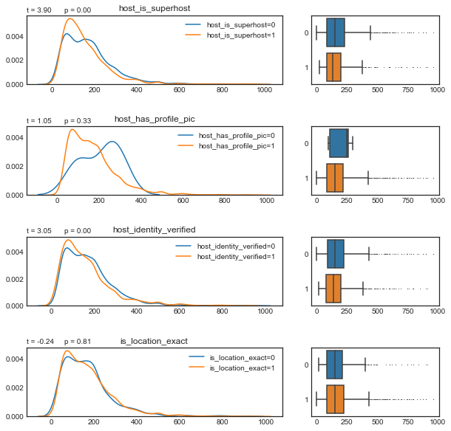
Host Details
Trust matters
Superhost status and verified identity more important than profile pictures
12

Slide 14
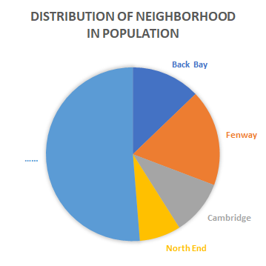
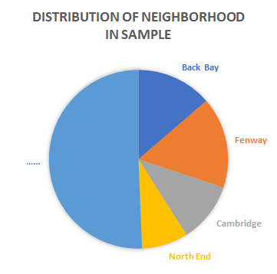
Sampling Method
A trade-off between accuracy and computing complexity
Cover features as much as possible in different neighborhoods
13

Slide 15
OLS Regression: Findings
Host details
Location
Tme effects
Variable | Coefficient*** | Standard error
host_has_profile_pic | 0.849 | 0.114
income_level | 0.224 | 0.004
location | 0.028 | 0.004
is_Fri_Sat | 0.068 | 0.002
Season_winter | -0.346 | 0.003
14

Slide 16
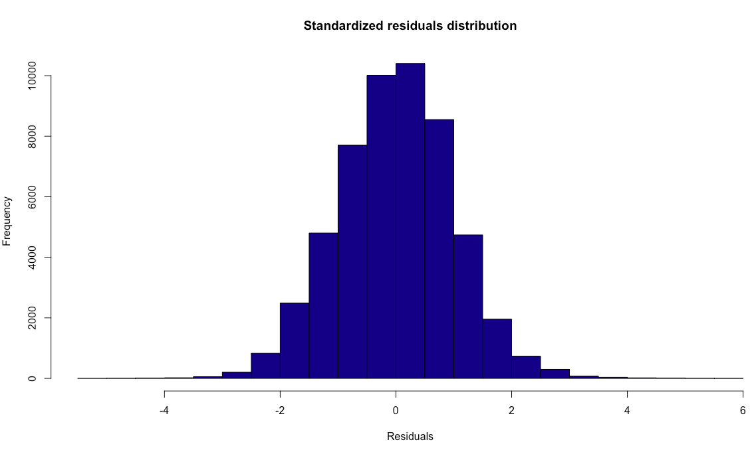
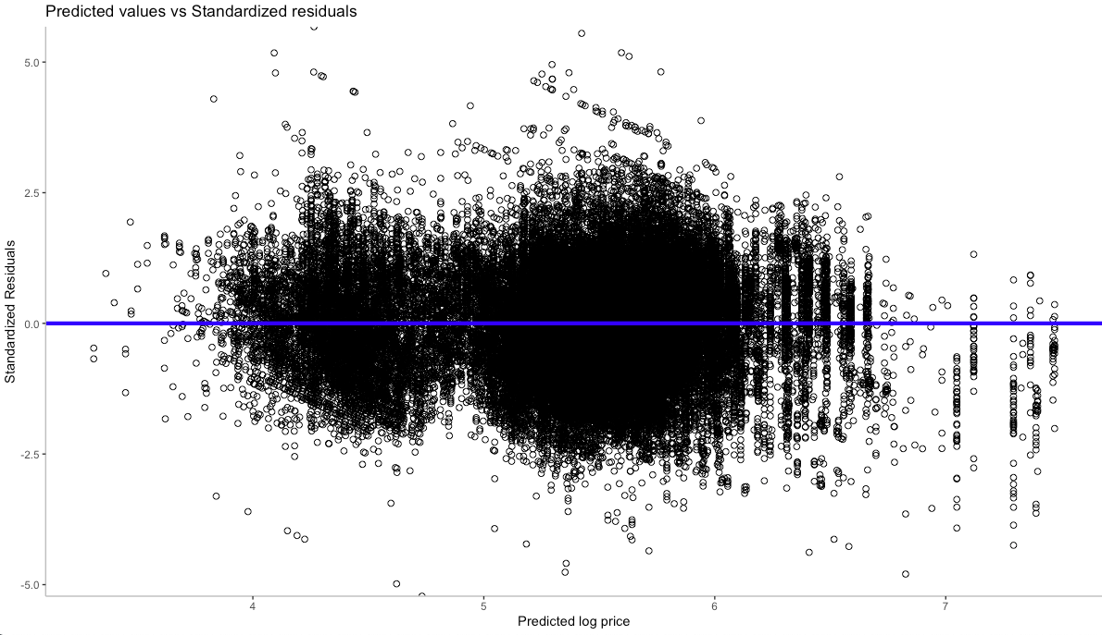
OLS Regression: Evaluation
Good fit for linear model
15

Slide 17
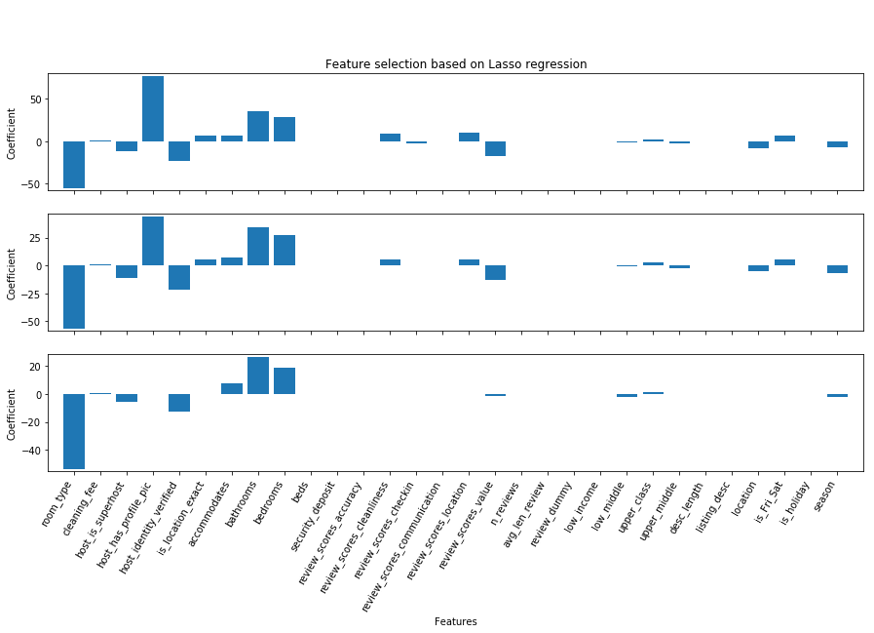
Machine Learning: Feature Selection
Advantage
Find important features
Consistent with assumption
Disadvantage
Low explained variance score
(about 0.4)
16

Slide 18
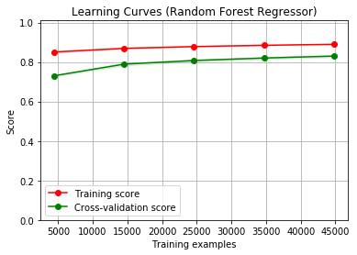
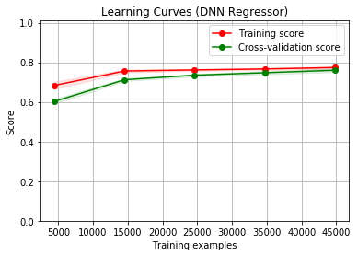
Machine Learning: Prediction
Model performance
Random Forest Regressor: 0.83
Deep Neural Network: 0.78
Improvement
Unignorable effects of Neighborhood
Non-linear relationship
17

Slide 19
Highlights
Label neighborhood by income levels
Capture weekends, holidays and seasons
Use NLP tools to mine host & reviews text
Use RFR & DNN methods to model hierarchically
18

Slide 20
Recommendations
Listing description ~ neighborhood
Capitalize on time effects
Update personal information
19
Notes:
Less about the experience more about location-based on bigram of review comments

Slide 21
“We’re going to make sure that we can stand behind every single listing, every single host to make sure that every single listing is accurate... the photos are what you say they are, the addresses are accurate…and the host is who they say they are.”
Brian Chesky
Co-founder and CEO of Airbnb
11.06.2019
Thank you!
20
Notes:
Less about the experience more about location-based on bigram of review comments

